Slide 1
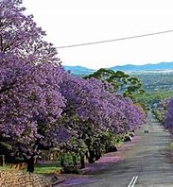
PRETORIA
SIMONA GODÁLOVÁ

Slide 2
PRETORIA
Pretoria, city in Gauteng province and administrative capital of the Republic of South Africa. Pretoria stretches along both sides of the Apies River and extends into the western foothills of the Magaliesberg on the east.

Slide 3
PRETORIA – MAP

Slide 4
PRETORIA - FLAG

Slide 5
PRETORIA – SEAL

Slide 6
PRETORIA – HISTORY
Founded in 1855 by Marthinus, son of Andries Pretorius, the Boer statesman for whom the city was named, it became the capital of the Transvaal in 1860, administrative capital of South Africa in 1910, and a city in 1931. During the South African War (1899–1902), Winston Churchill was imprisoned there (1899) until his escape. The Peace of Vereeniging, ending the war, was signed at Melrose House on May 31, 1902.

Slide 7
PRETORIA
Pretoria is well-planned and famous for its streets lined with jacaranda trees. Church Street stretches east-west for 12 miles (20 km). The post-World War II boom is evidenced by skyscrapers around Church Square. Landmarks commemorate Boer history (notably the Voortrekker Monument and the Paul Kruger and Louis Botha statues). Cultural attractions include the Kruger Museum, the National Cultural History Museum, and an art museum.

Slide 8
PRETORIA – PIET RETIEF

Slide 9
PRETORIA – UNIVERSITY OF SOUTH AFRICA

Slide 10
PRETORIA – UNIVERSITY OF PRETORIA

Slide 11
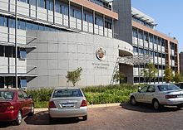
PRETORIA – TSHWANE UNIVERSITY OF TECHNOLOGY

Slide 12
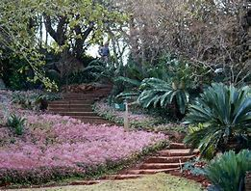
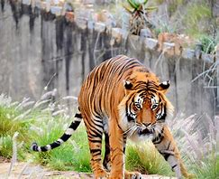
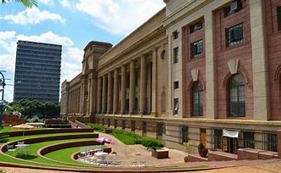
PRETORIA
PRETORIA IS NICE PLACE
PRETORIA HAS BEAUTIFUL BOTANIC GARDENS , A GREAT ZOO AND LOTS OF MUSEUMS

Slide 13
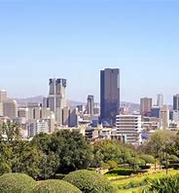
THANK YOU !

