Slide 1
Mária Magdaléna Milatová

Slide 2
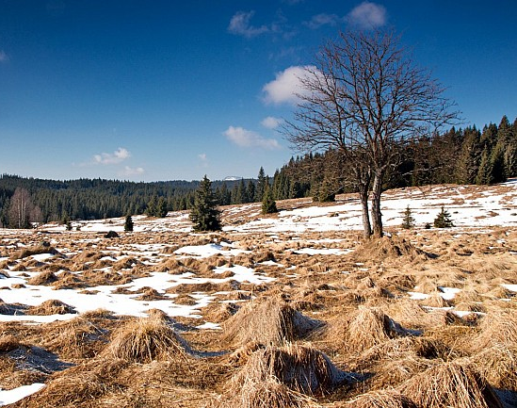
TUESDAY 23.3.2021
On Tuesday, it was snowy. But it wasn´t rainy. It was wet too. It was cold. It was no more than two degrees. And it was partly cloudy.

Slide 3
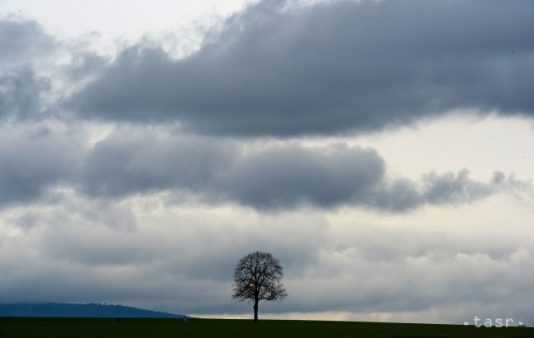
WEDNESDAY 24.3.2021
On Wednesday, it was cloudy. It was windy too. But it wasn´t snowy or rainy. It was cold. It was two degrees.

Slide 4
THURSDAY 25.3.2021
On Thursday, it was partly cloudy. It wasn´t clear, but it was warmer than the last days. It was nine degrees. But it wasn´t dry. It was wet.

Slide 5
FRIDAY 26.3.2021
On Friday, it was sunny. And it was warm. It was fourteen degrees, warmer than the last days. It was almost completely clear. I think, it was wet too.

Slide 6
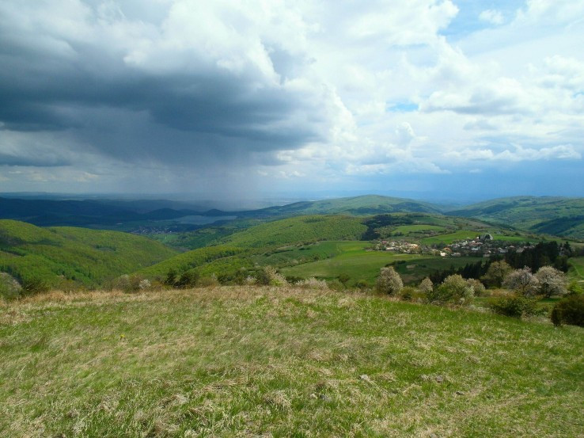
SATURDAY 27.3.2021
In Saturday morning, it was sunny. But in the afternoon, it was cloudy. And at the night, it was rainy. It wasn´t stormy weather. It was windy too. But it was warm. It was sixteen degrees.

Slide 7
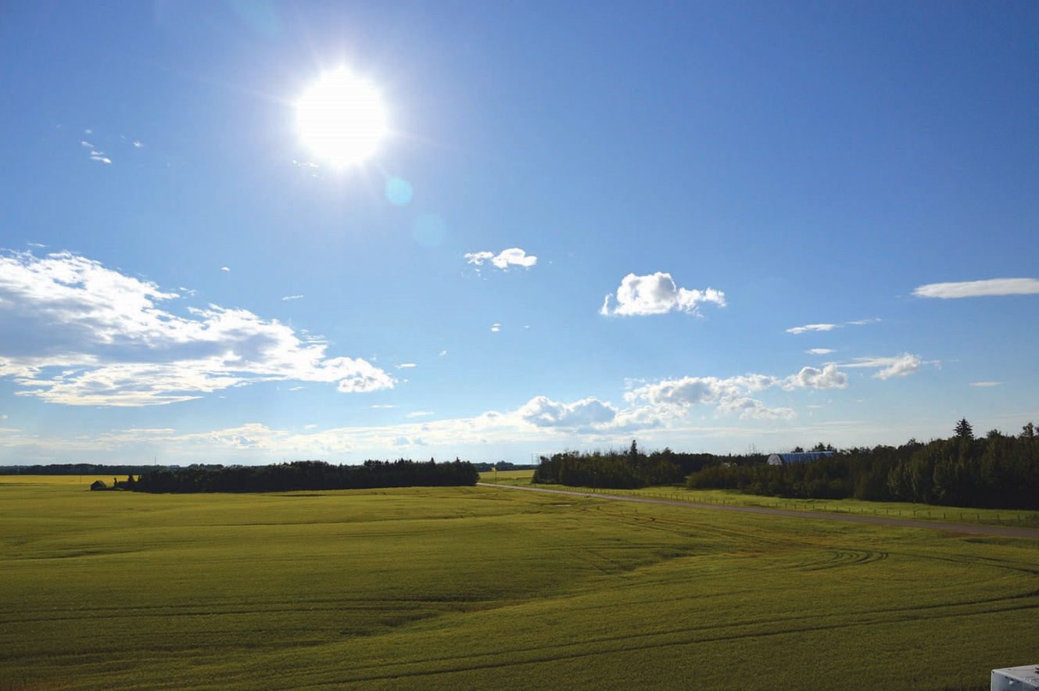
SUNDAY 28.3.2021
In Sunday morning, it was partly cloudy. It was wet, because yesterday was rainy. It was seven degrees. In the afternoon, it was sunny. It was almost completely clear. I think, it was windy too.

Slide 8
MONDAY 29.3.2021
On Monday it was partly cloudy. It was windy too. It was twelve degrees. At night, it was rainy. But it wasn´t stormy weather.

Slide 9
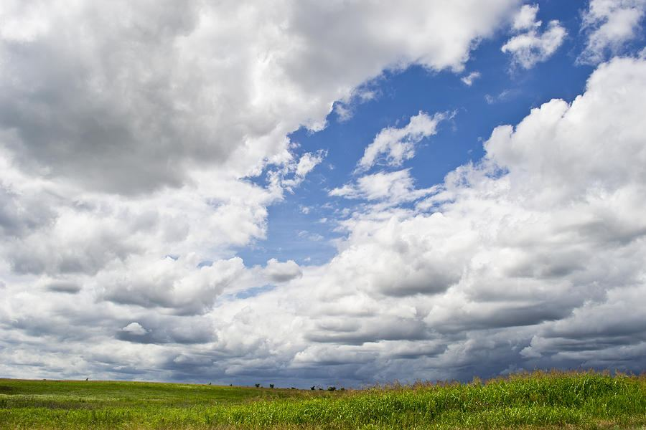
TUESDAY 30.3.2021
Today it was cloudy. It was ten degrees. It was windy too. It was wet too. In the afternoon, it was better weather. It was partly cloudy.

Slide 10
THE END
Thank you for your time!

